Slide 1
Misunderstanding Between Team Members
Presented by the team
P
K
M
P
Y

Slide 2
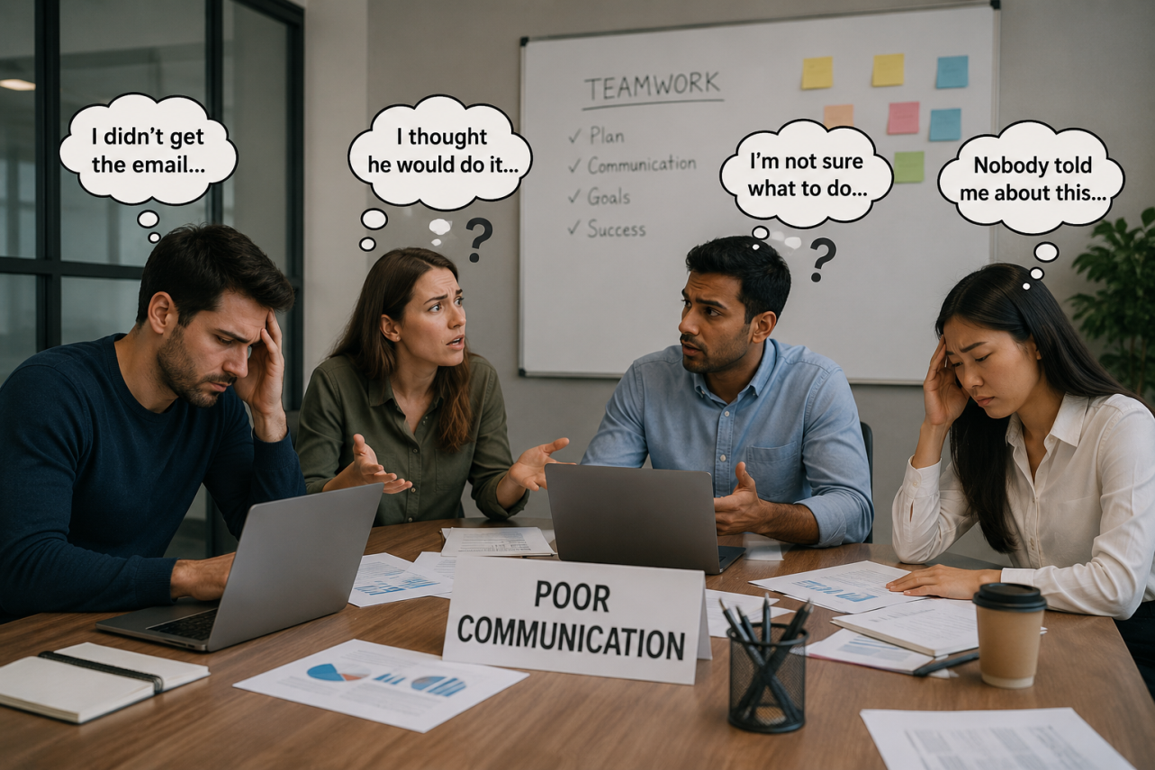
Problem:
Poor Communication between members.
-Team members do not share information clearly
-Messages are misunderstood
-Important details may be missed

Slide 3

Solution:
Regular Team Meeting
Shared Communication Platforms
Assign Clear responsibilities

Slide 4


Implementation:
-Hold weekly or daily meetings.
-Allow members to ask questions.
-Share project documents in a shared file.

Slide 5



Expected Benefits:
Better Team Coordination
Fewer Mistakes
Better Time Management
Improved Project Quality

